Slide 1
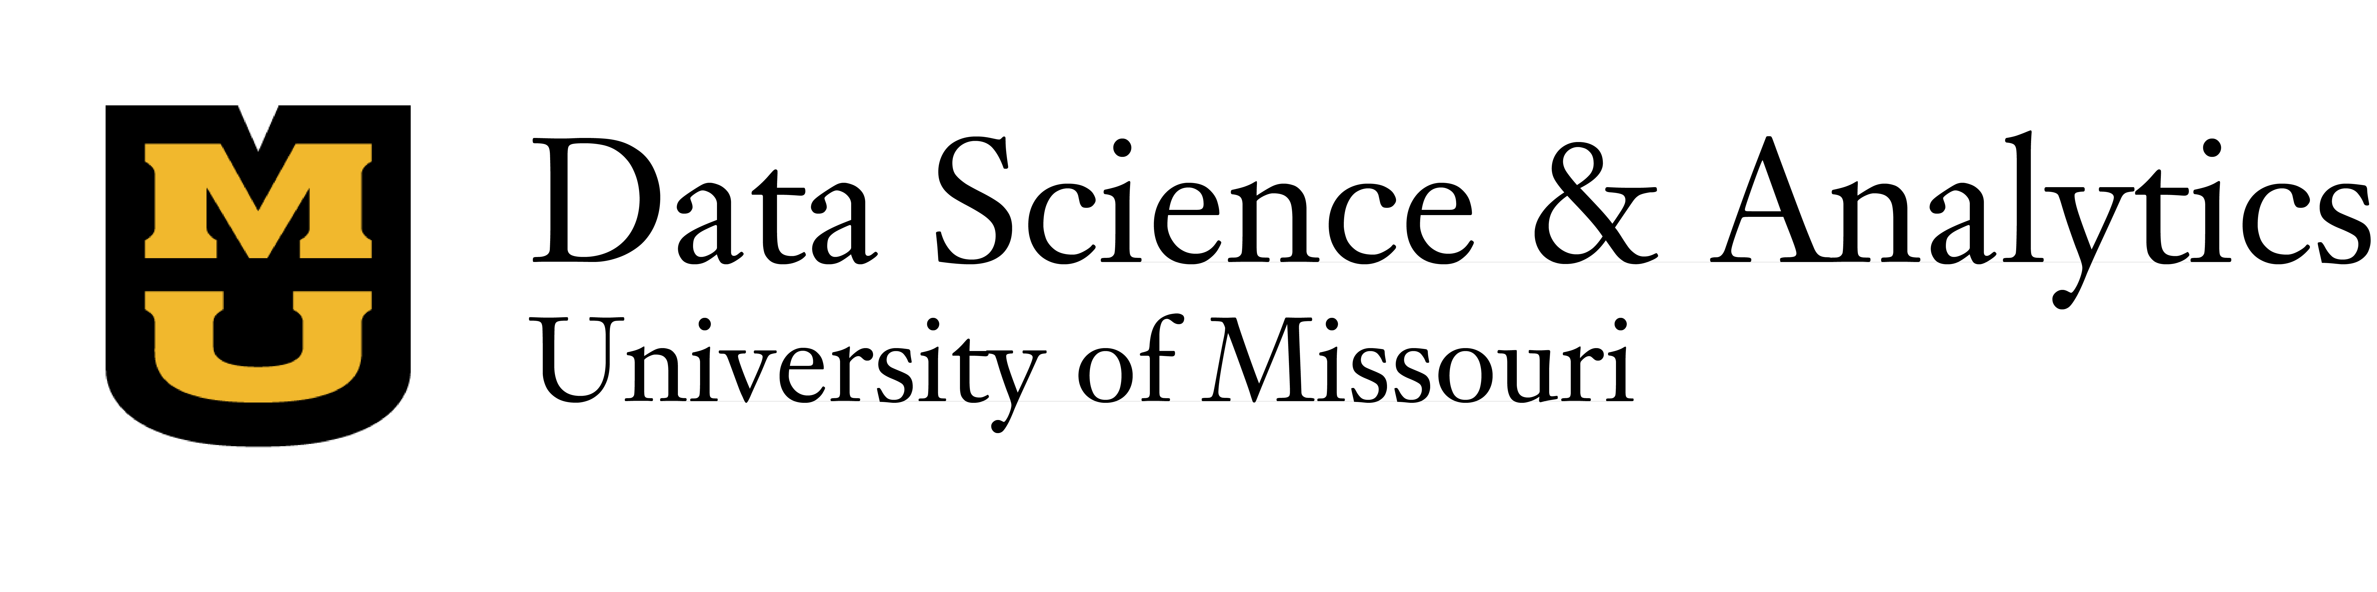
Predicting Osteoporotic Fracture Incidence in Men From Lifestyle Factors

Slide 2
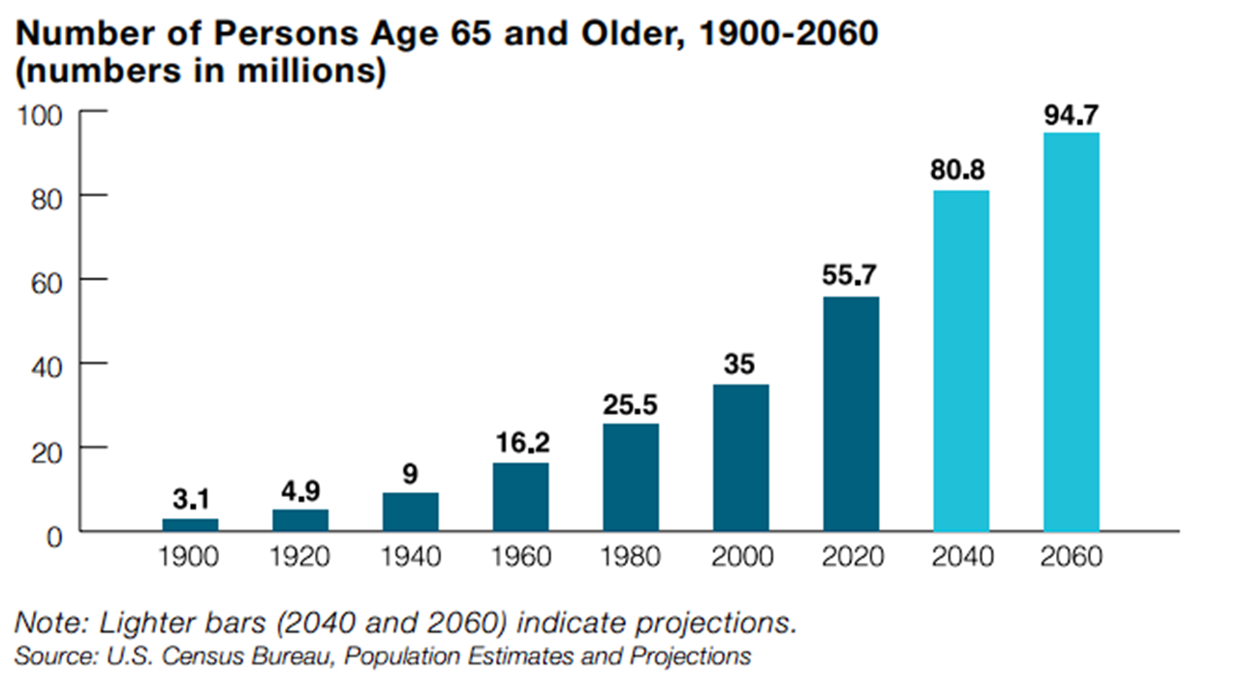
Purpose
Each year a growing number of adults in the US are negatively impacted by the effects of fractures
"In 2019, the global number of new cases of fracture was estimated to be 178 million (95% UI 162–196), an increase of 33·4% (30·1–37·0) since 1990. The number of new cases of fractures was 102 million (93·4–111) in males compared with 76·4 million (68·7–85·3) in females."
Cauley JA. The global burden of fractures. Lancet Healthy Longev. 2021 Sep;2(9):e535-e536. doi: 10.1016/S2666-7568(21)00183-5. Epub 2021 Aug 20. PMID: 36098004.
Notes:
We can see from the chart that the number of elderly persons in the United States is only expected to increase, and with it the prevalence of fractures

Slide 3
Purpose
Fracture Statistics
20-30% of all men will have an osteoporotic fracture in their lifetime
20% of hip fracture patients require long-term nursing home care
50% NEVER regain ability to walk independently
20% die within one year
33% of people are completely dependent following hip fracture
Adler RA. Osteoporosis in men: a review. Bone Res. 2014 Apr 29;2:14001. doi: 10.1038/boneres.2014.1. PMID: 26273515; PMCID: PMC4472130.

Slide 4
Context
Our team aims to identify and understand the impact of lifestyle factors, medical history, and biomarkers on fracture risk.
This project intends to serve healthcare professionals, policymakers, and individuals at risk, providing insights to prevent fractures, improve patient outcomes, and allocate healthcare resources more efficiently.
Notes:
Lifestyle factors such as physical activity and diet
Healthcare Professionals: We aim to provide them with a tool that can help them identify patients at high risk and guide them in implementing appropriate preventative measures.
Policy Makers: Our insights can help inform healthcare policies and resource allocation decisions aimed at reducing the prevalence of fractures and improving patient care.
At-risk Individuals: By making our findings accessible to the general public, we can raise awareness about the risks and prevention strategies associated with fractures, empowering individuals to take charge of their own health.

Slide 5
Domain Questions
What is the impact of lifestyle factors such as exercise, diet, and alcohol intake on bone mineral density and the risk of fractures in age 50+ males?
What specific biomarkers can be indicative of increased fracture risk?
Notes:
A predictive model with quantifiable accuracy and reliability metrics (e.g., accuracy, precision, recall, and AUC-ROC) for assessing fracture risk based on these factors.

Slide 6
Data
The Osteoporotic Fractures in Men (MrOS) Study
Multi-center observational study of 5,994 men
Baseline examinations conducted between 2000-2002
Four subsequent examinations have taken place, with the last examination in 2017
Participants contacted three times each year for ascertainment of fall, fractures, and deaths
Wide variety of variables including visual and cognitive function tests, bone mineral density (BMD), the collection of biospecimens, mobility, and objective assessment of physical activity levels
Notes:
Funded by NIH
With over 41,000 variables across seven time points

Slide 7
Outcome
The desired outcome will be a predictive model that can accurately predict the incidence of fractures from lifestyle factors such as diet and physical activity, as well as medical history and specific biomarkers included within the MrOS dataset. The model could then be utilized in healthcare settings to guide treatment plans and preventative measures.
Other goals are to identify risk factors, common trends, and perform exploratory analysis.

Slide 8
Technology
We intend to leverage supervised learning to classify patients at risk for bone fracture.
A variety of decision tree algorithms such as Random Forest, XGBoost and LightGBM will be explored as these models make for great classifiers and can also appropriately handle missing values.
Dimension reduction or feature extraction techniques to handle the high dimensionality of the data.
Notes:
Missing null values

Slide 9
Justification
Enhanced Patient Outcomes
Financial Benefits
Efficient Resource Allocation
Policy Development
Risk Reduction
Social Impact
Notes:
We see our project as having benefits in 6 different categories
We would like to focus on two specifically: Enhanced Patient Outcomes and Financial Benefits
Enhanced Patient Outcomes
By predicting the likelihood of fractures based on lifestyle factors, medical history, and biomarkers, healthcare professionals can intervene proactively, enabling better patient care and improving overall health outcomes.
Financial Benefits
In terms of financial impact, preventing fractures can lead to significant cost savings for healthcare systems.
#####
Efficient Resource Allocation
The predictive model will help healthcare systems identify high-risk individuals, allowing for more targeted interventions and efficient allocation of healthcare resources.
Policy Development
The insights derived from this project can be utilized by policy makers to draft guidelines and regulations aimed at reducing the incidence of fractures, especially in high-risk demographics such as senior citizens.
Risk Reduction
By identifying key risk factors and their impact on bone fractures, this project can contribute to the development of preventive measures, reducing the overall risk of fractures. This can result in lower long-term healthcare costs.
Social Impact
On a broader level, this project could significantly enhance quality of life for individuals, particularly senior citizens, by reducing their risk of fractures.

Slide 10
Desired Deliverable
The planned and desired deliverable for this project is a predictive model, informed by the comprehensive data collected in the Osteoporotic Fractures in Men (MrOS) study.
This model will provide actionable insights to healthcare professionals, policy makers, and individuals at risk, allowing them to make data-driven decisions to reduce the incidence of fractures, optimize patient outcomes, and deploy healthcare resources efficiently.
In summary, the desired final product will be a holistic, data-driven solution that can provide valuable insights into fracture risks, thereby aiding in the prevention, treatment planning, and resource allocation in managing fractures, particularly in the senior citizen population.

